Slide 1


ClothBridge
Team Code : 301 220
1- Ahmed Abo El-Hassan 2-Mohamed Karam
3- Alaa Yasser 4- Roaya Mohamed
5- Malak Hany

Slide 2






Agenda
Problem
Empathy map
Design Requirements
SDG
Prior Solutions

Slide 3

Problem
Problem
What
Who
Why
Idea
A large number of low or limited-income groups are unable to buy clothes due to high prices.
Low-income individuals.
Clothing donors.
Charity Organizations.

Slide 4
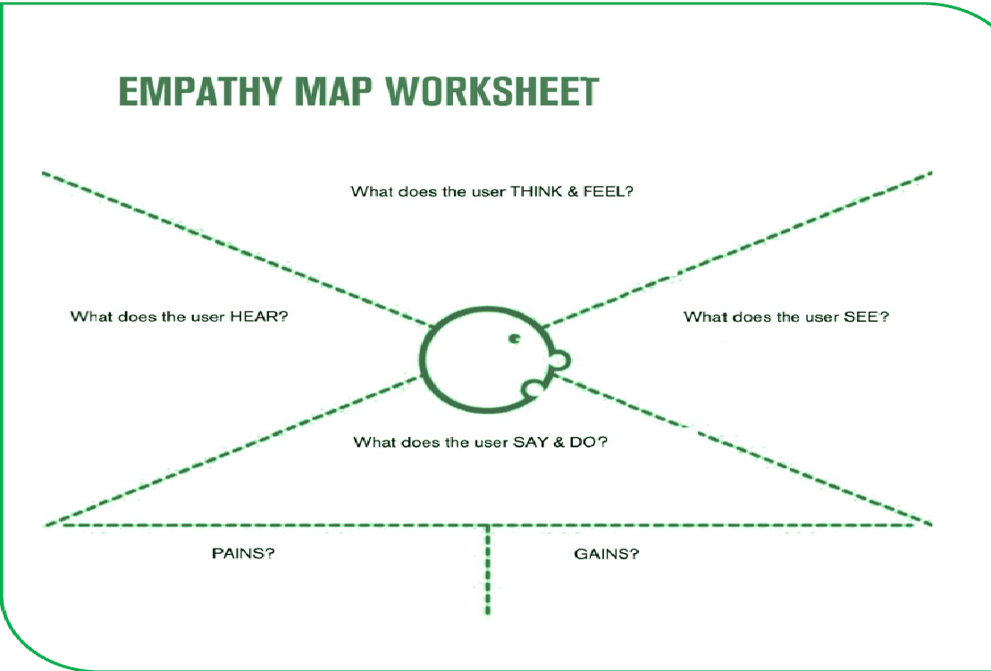
Empathy map
1.Concerned about rising clothing prices.
2.Looking for an any easy and secure way.
3.Wants to support his family on a limited budget.
1.Complaints about high prices.
2.Advice about donation places.
3.Experiences of people who faced the same problem.
1.High prices in the market.
2.Websites not designed for his situation.
3.Difficlty reaching charitable organizations.
1.Search for lower prices.
2.Compares prices before purchasing.
3.Use mobile phone for browsing
1.Limited budget.
2.Difficulty accessing a trusted source.
3.Fear of exploitation or insecurity.
1.Good-quality clothes at an affordable prices.
2.A trusted and easy platform.
3.Easy access through mobile devices.

Slide 5
Prior Solution
1.People used to buy clothes from traditional stores at normal or high prices.
2.There are some clothing donation websites, but they:
Focus only on donations without an organized purchasing system.
Are not specifically designed for low-income users.
3.Some platforms serve only one group, such as:
Websites dedicated only to charities.
Websites designed only for donors.
Websites that sell clothes only to the targeted beneficiaries.

Slide 6
Design Requirements
Functional
Registration Page
Non-Functional
Performance
Login Page
Home Page
Search & Filter
Contact Page
Donation Page
Shopping Cart
Security & Privacy
Usability & Accessibility

Slide 7

SDG
SDG 1 : No poverty :-
Its goal is to reduce poverty by providing clothes to people with low or limited income. This helps create equality and kindness between different social groups in the community.

Slide 8
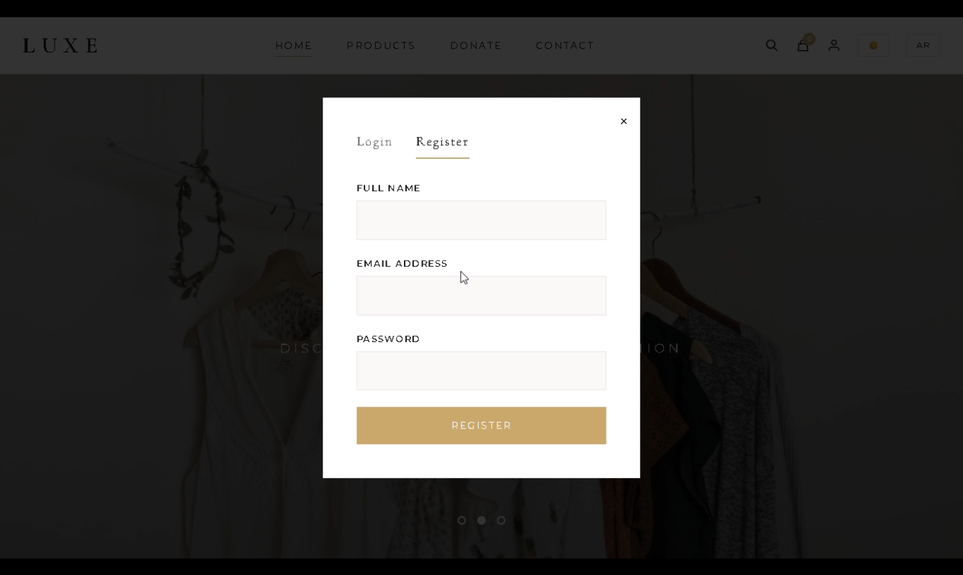
Functional Requirements
Registration Page:-
The user can create account
  The user enters name , email and password.
  The system verifies the information.
  The account is successfully created.

Slide 9
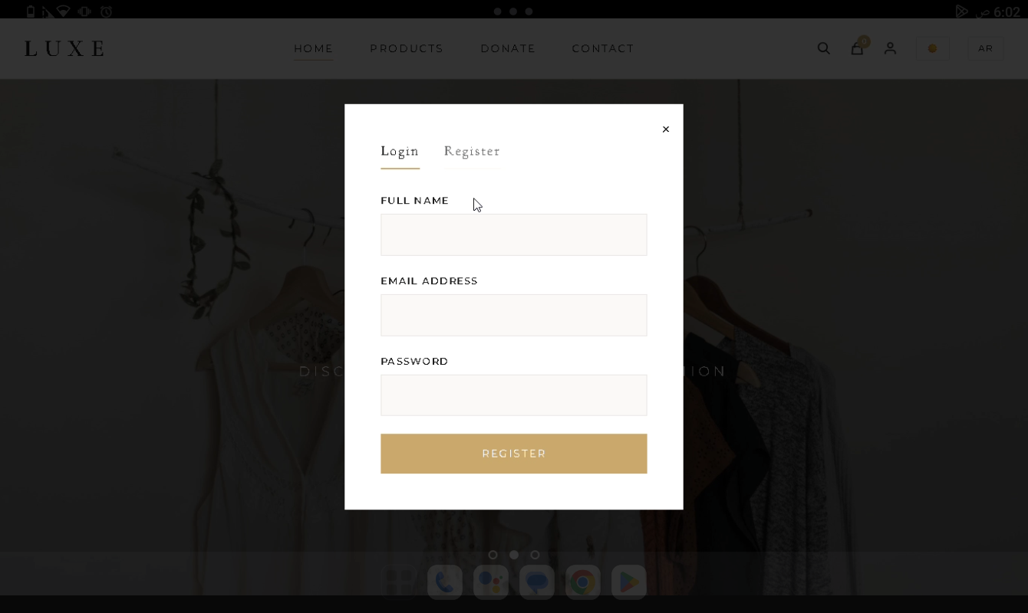
Functional Requirements
Login Page:-
The user can log in to the webs
  The user enters name , email and password.
  The system checks the credentials.
  The user accesses their account.

Slide 10
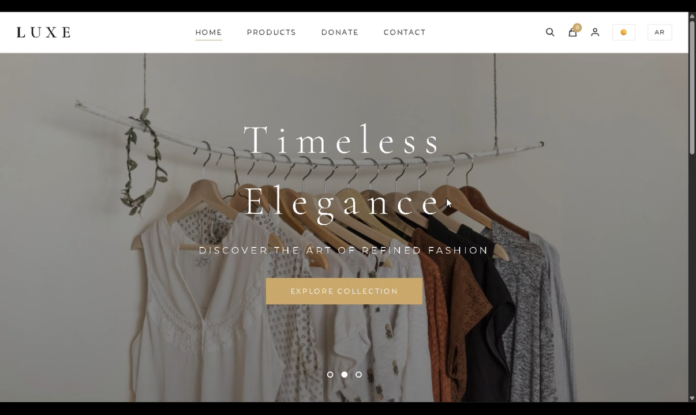
Functional Requirements
Home Page:-
The user can browse clothes by category
  The user can use the search bar to find products.
  The user can switch languages.
  The user can toggle Dark / Light Mode.
  The user can access Profile.
  The user view shopping cart.

Slide 11
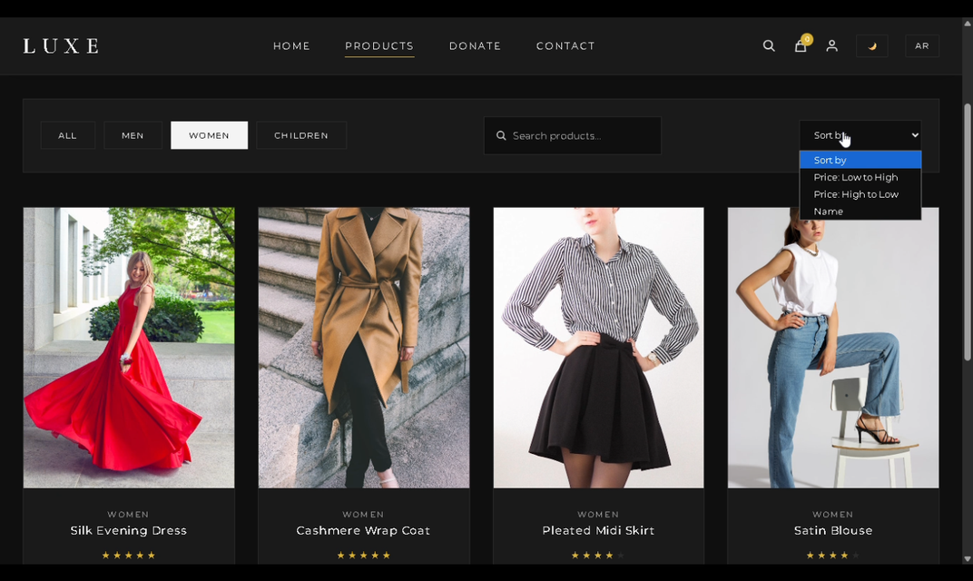
Functional Requirements
search & Filter:-
The user can search and filter items
  The user can search for specific items.
  The user can sort by price or name.
  The system displays matching results.
  The user can filter items “all, men ,women , children”.

Slide 12

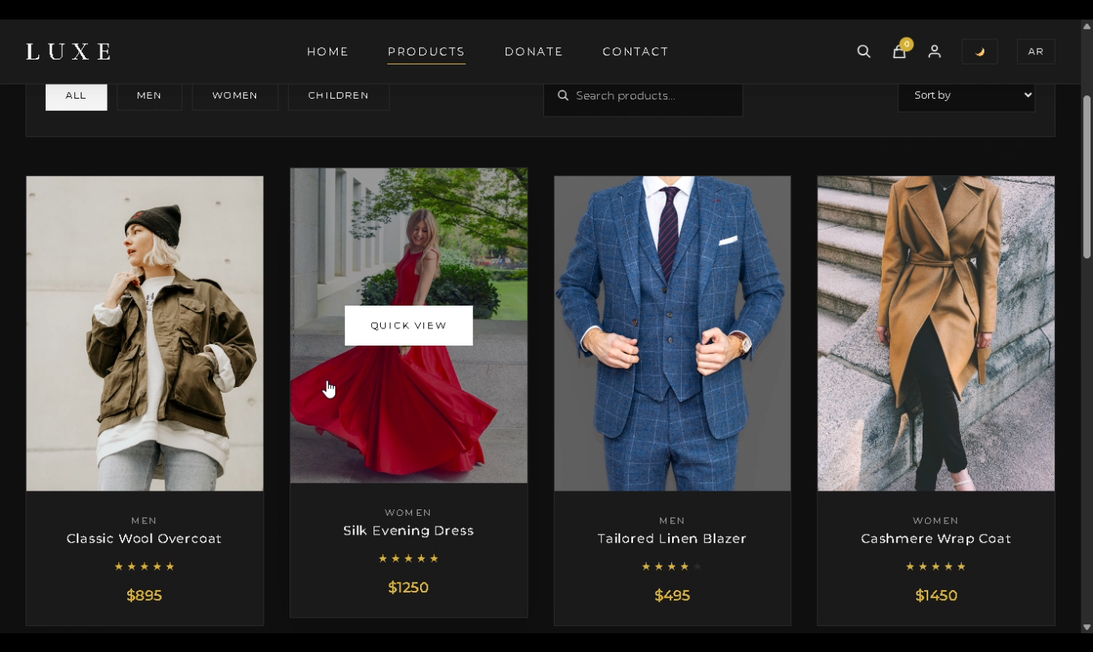
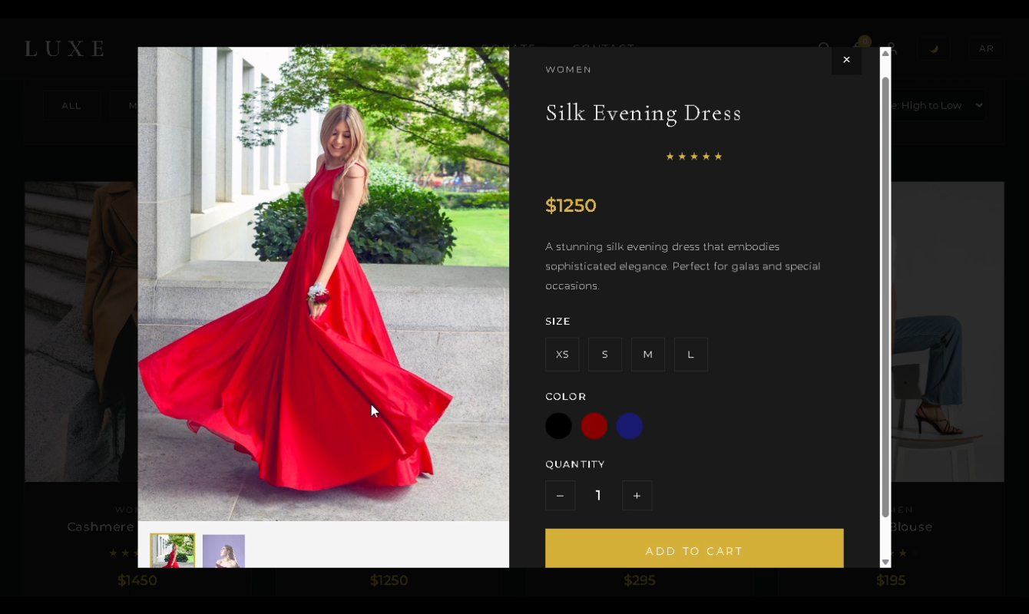
The button
shows more details about the product.

Slide 13
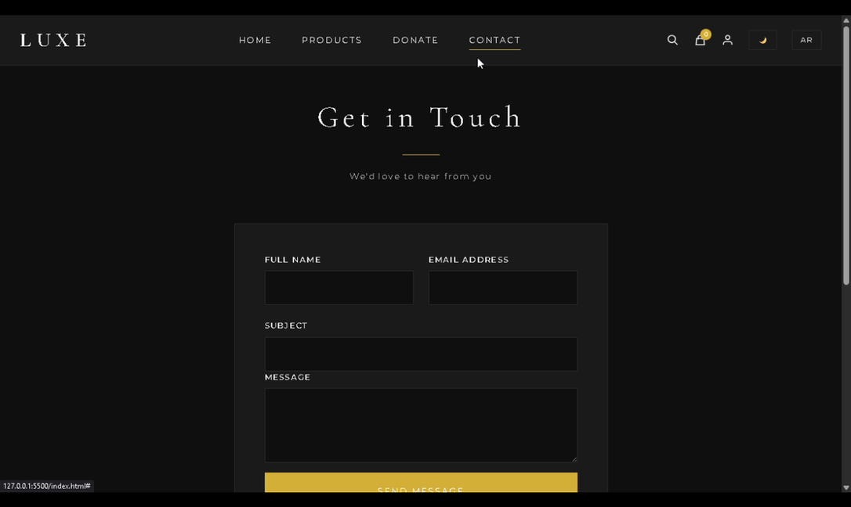
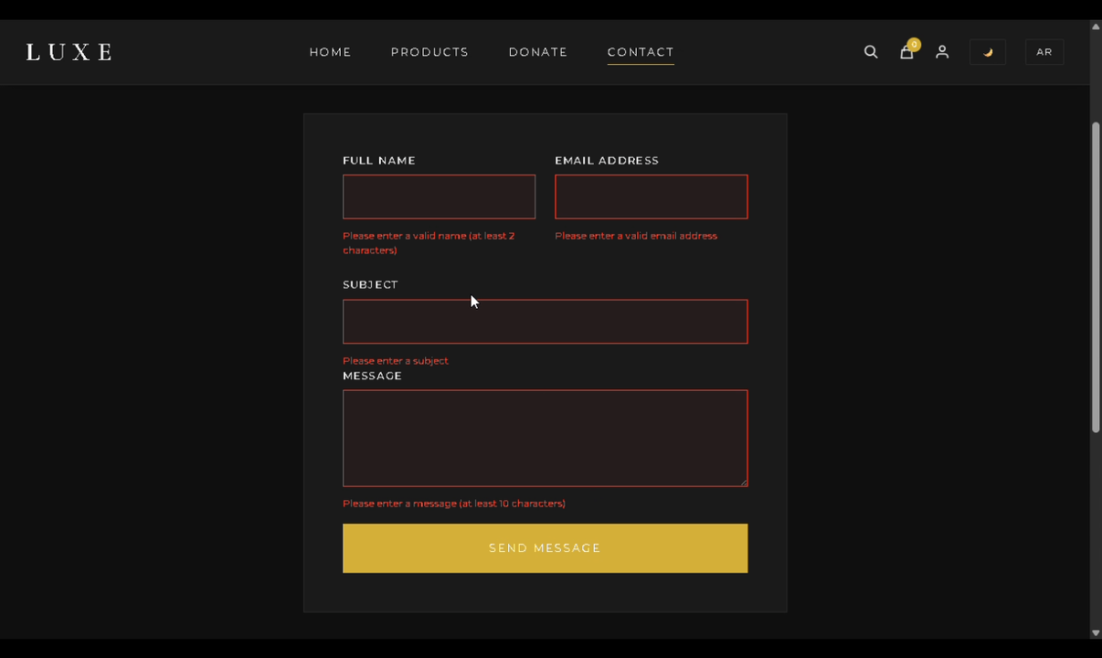
Functional Requirements
Contact page:-
  The user can access contact page.
  The user can send a message through
  a contact form.
  The contact form validates user input before submission.

Slide 14
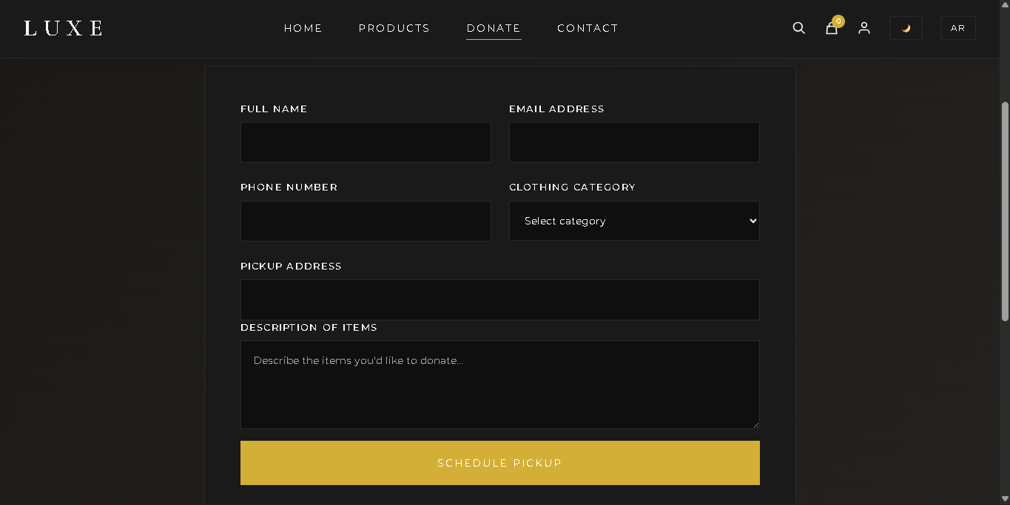
Functional Requirements
Donation Page:-
The user can donate clothes through
a donation form.
  The user can uploads clothes for donation.
  The user provide item details and condition.
  The donation request is submitted.

Slide 15
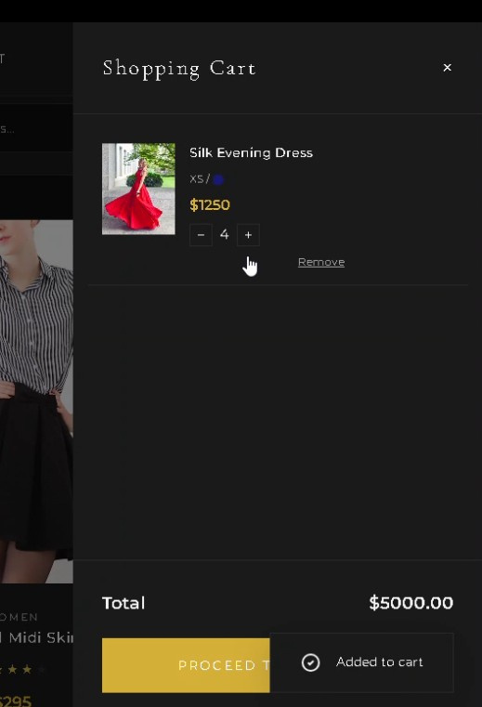
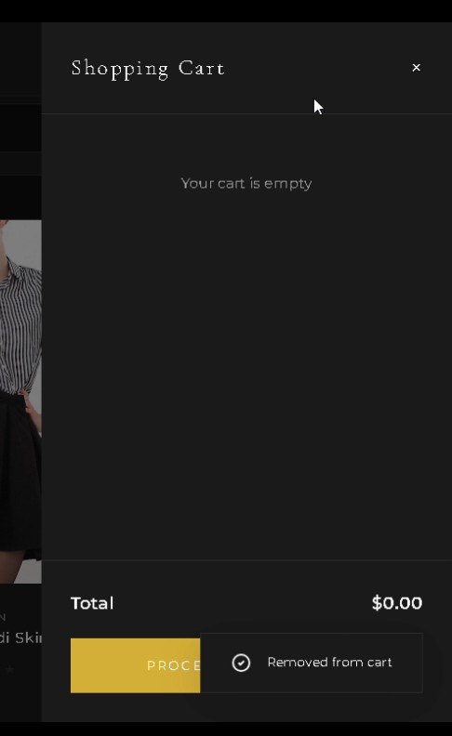
Functional Requirements
shopping cart :-
The user can add items to the cart
  The user can add , remove and
  update items into cart.
  The user can shows the total price.

Slide 16
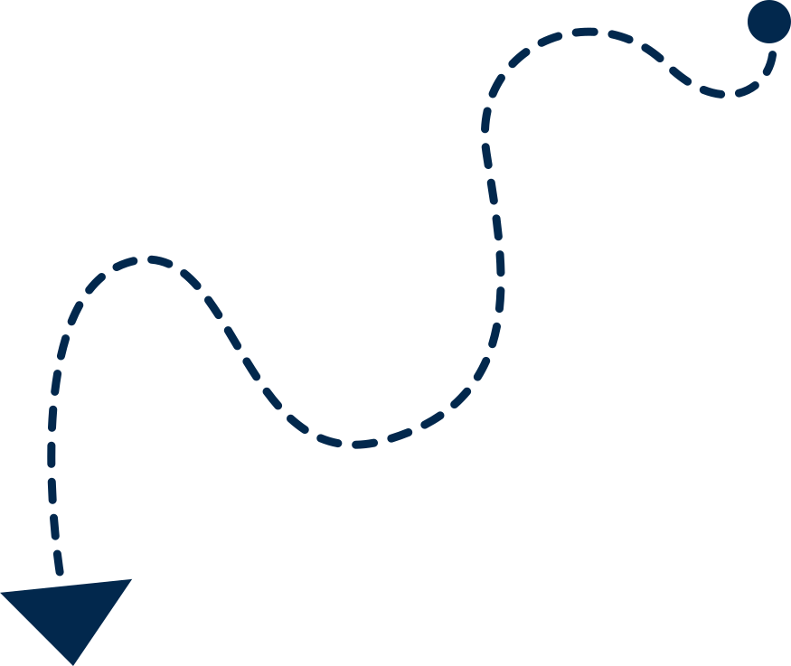
Prototype

Slide 18

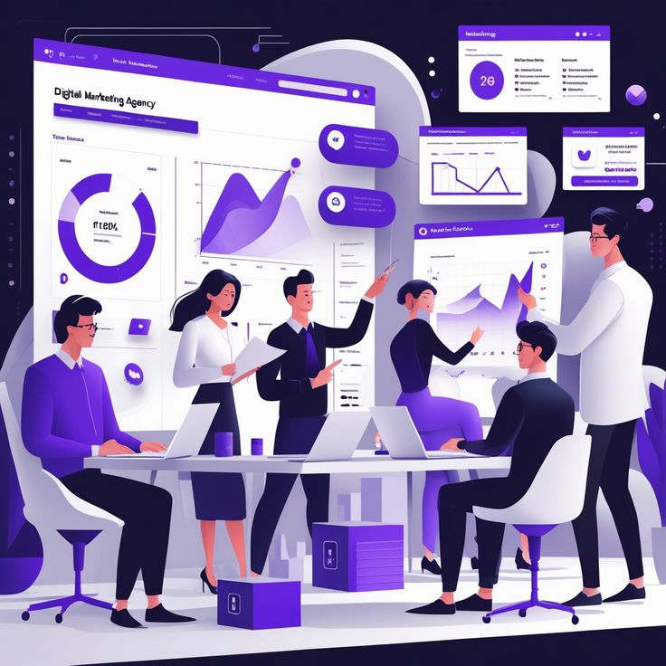
Thank You for Listening
Presented by :
Team 5
Supervised by :
Eng.Zyad Saeed

